Slide 1
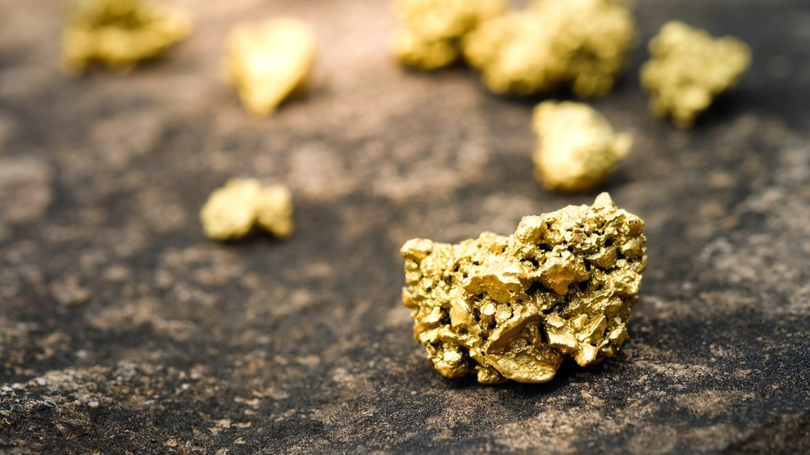

Awakening the Giant
Building a mining camp around the Sleeping Giant Mine & Mill
February 2026

Slide 2
FORWARD-LOOKING STATEMENTS
Except for statements of historical facts, some statements contained in this presentation, constitute forward looking statements, including, without limitation, anticipated developments in the Company’s operations in future periods and other events or conditions that may occur in the future. These statements are about the future and are inherently uncertain and actual achievements of the Company or other future events or conditions may differ materially from those reflected in the forward-looking statements due to a variety of risks, uncertainties and other factors. Management believes that the expectations reflected in those statements are reasonable, but no assurance can be given that these expectations will prove to be correct. It is recommended not to place undue reliance on forward-looking statements as the plans, intentions or expectations upon which they are based might not occur. Most data are a summary of information found on Sedar+ and the official website of the company. For complement of information, one should look at those as they are the original source of this presentation.
Qualified Person
The scientific and technical content in this presentation has been reviewed and approved by Mr. Pascal Hamelin, ing, President and CEO of Abcourt, who is a "qualified person" within the meaning of NI 43-101

Slide 3
Why Invest in Abcourt?
Emergent Gold Producer through its 100%-owned Sleeping Giant Mine and Mill, which includes an updated resource, a positive Preliminary Economic Assessment (PEA), an operational and fully permitted 950 tpd mill with all surface, underground infrastructure in place, and advancing the production ramp up to 30,000 Au oz per year in the coming 12 months.
The production development and the first stope production began in July 2025.
Mill began to process ore in August, and first pour was in September 2025.
Upside with Major Gold Discovery in 2024 at Cartwright East of the Flordin deposit (90 km East of the Sleeping Giant Mill).
Growing around our Sleeping Giant Mill in Quebec with ~500 km² of strategic landholdings and 13 early-to-advanced stage gold projects across the major gold district of the Abitibi Greenstone belt in Quebec. All within trucking distance from our Mill.
Many upcoming catalysts, operational update from Sleeping Giant production ramp up, results from the underground drill program at Sleeping Giant, Exploration activities on surface at Flordin-Cartwright.

Slide 4
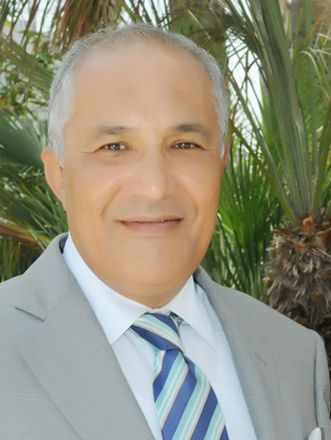

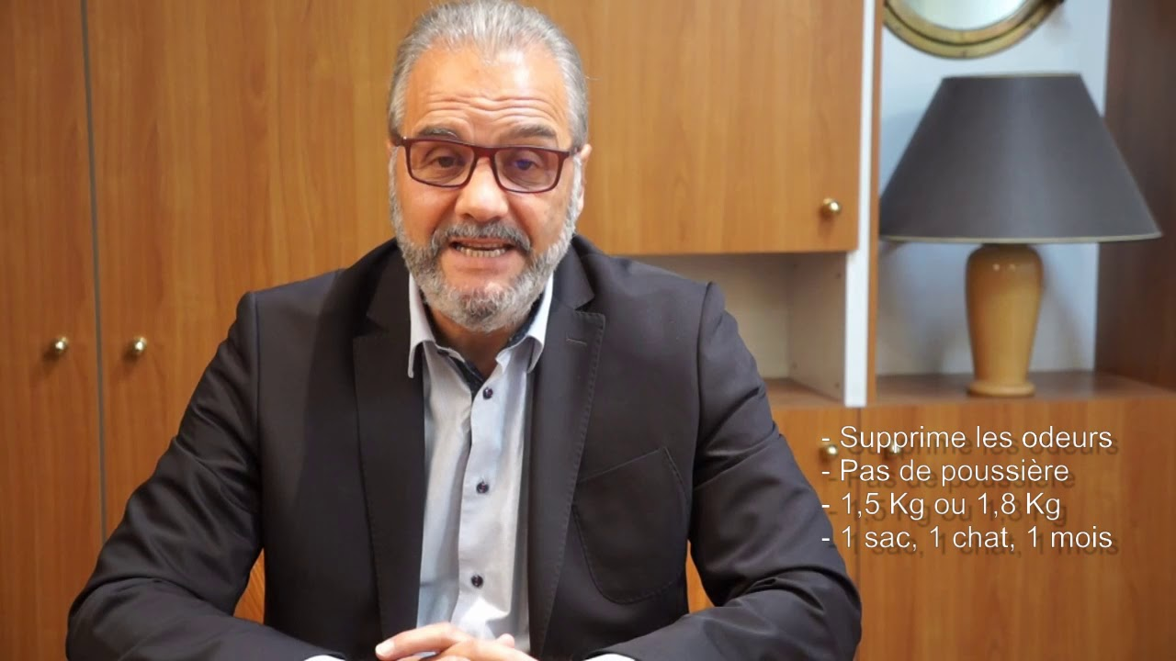
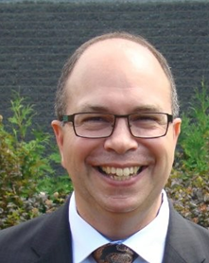


Experienced Board Focused on Shareholder Value
Noureddine Mokaddem│ Chairman of the Board
Mining engineer with 40 years of professional experience in Africa and North America.
Successfully managed all stages of implementation in several projects, from feasibility studies to start-ups of production units of different scales, including maintenance of complex units.
Founder, president and CEO, chairman of the Board of Directors of the mining company Aya Gold & Silver Inc., listed on the Toronto Stock Exchange from 2010 to 2020.
Board member of Abcourt since July 2024
Pascal Hamelin│ CEO & Director
Mining engineer with 34 years of experience in mining and project management
Has years of experience in underground precious metal operations
Holder of a degree in mining engineering and member of the Ordre des ingénieurs du Québec (Ing.) and of the Professional Engineers Ontario (P. Eng)
Joined Abcourt in April 2022 as CEO
François Mestrallet │ Director
A veterinarian and member of the “École nationale vétérinaire” of Lyon, France since 1980
Since 1983, he has been the President of Demavic, a private company located in France and manufacturing materials for animals
Abcourt Board member since 2013
Éric Gratton│ Director & Audit Chair
Chartered Professional Accountant with over 30 years of management experience and has spent the last 15 years working in the mining industry.
Prior to his career in mining, he served as a logistics officer in the Canadian Army for 22 years.
Board member of Abcourt since February 2025
René Branchaud │ Director
Lawyer since 1983, and Partner of the law firm Lavery, de Billy L.L.P
Secretary of Midland Exploration Inc.,
Director and Secretary of Genius Metals Inc.
Board member of Abcourt since 2021
Chad Williams│ Director
Bachelor of Engineering degree, a Master of Business Administration from McGill University and a member of the Professional Engineers Ontario (P. Eng)
Over 35 years experience in capital markets and business management
He is the founder and Chairman of Red Cloud Mining Capital Inc, Honey Badger Silver, Mines D’Or Orbec and Sharechest.
Board member of Abcourt since August 2025
Board of Directors with >200 years of combined mining, capital markets & corporate governance experience

Slide 5
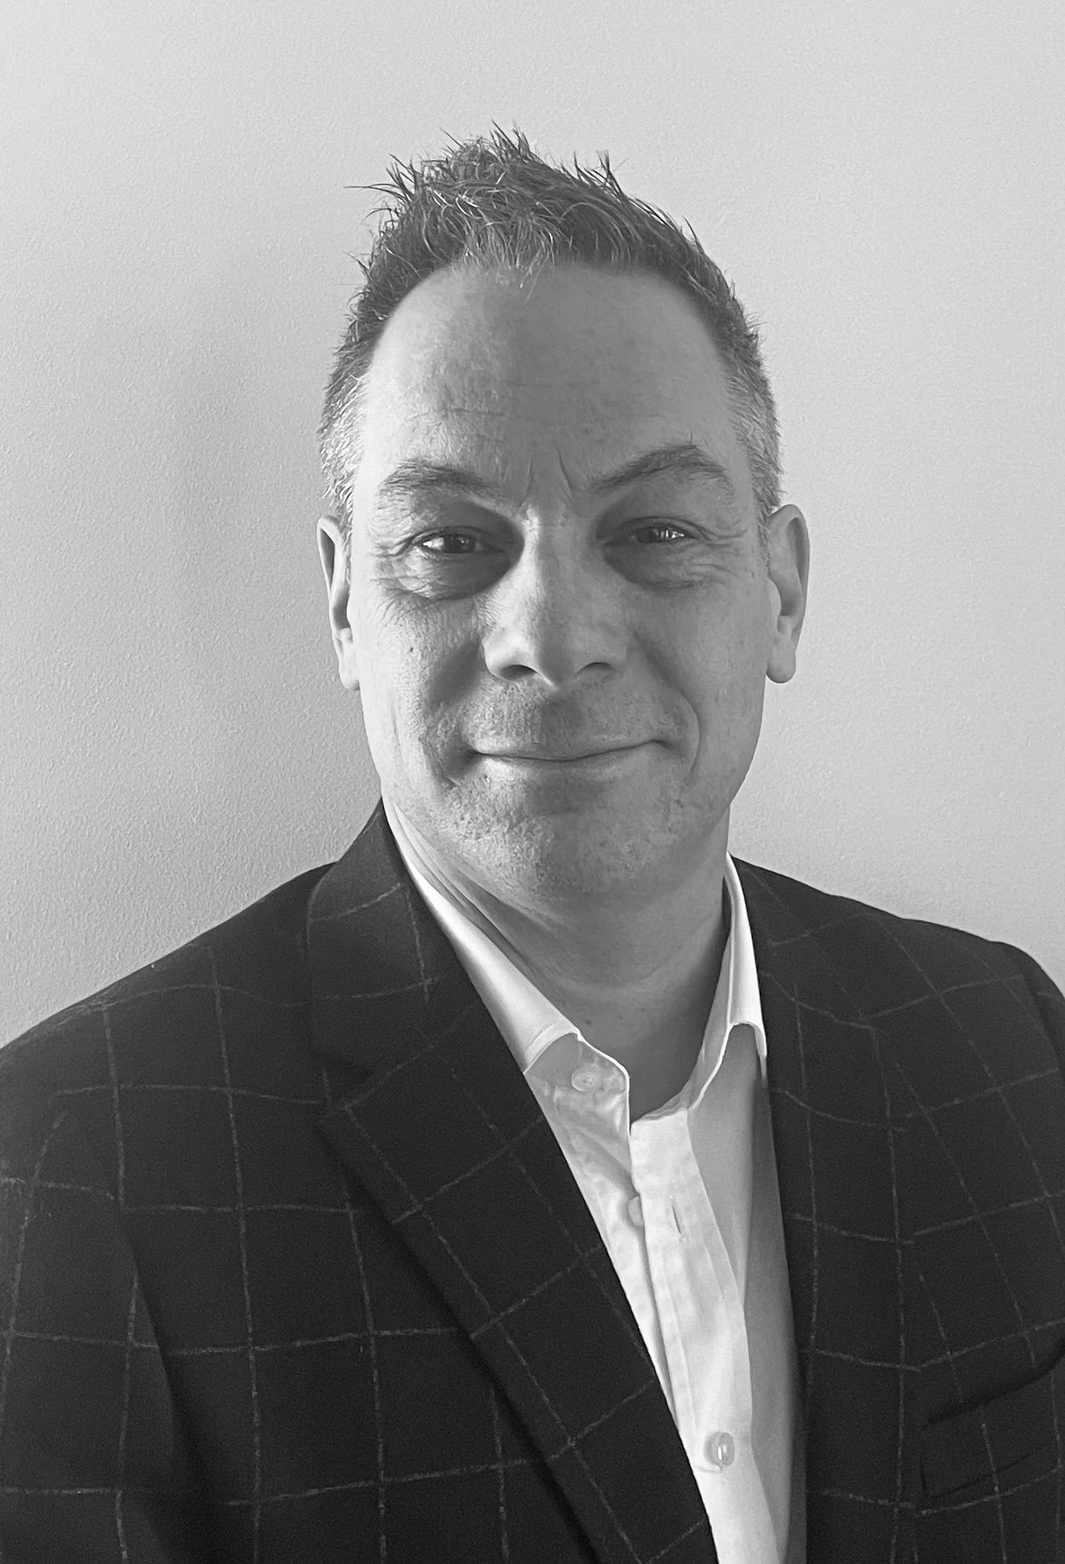

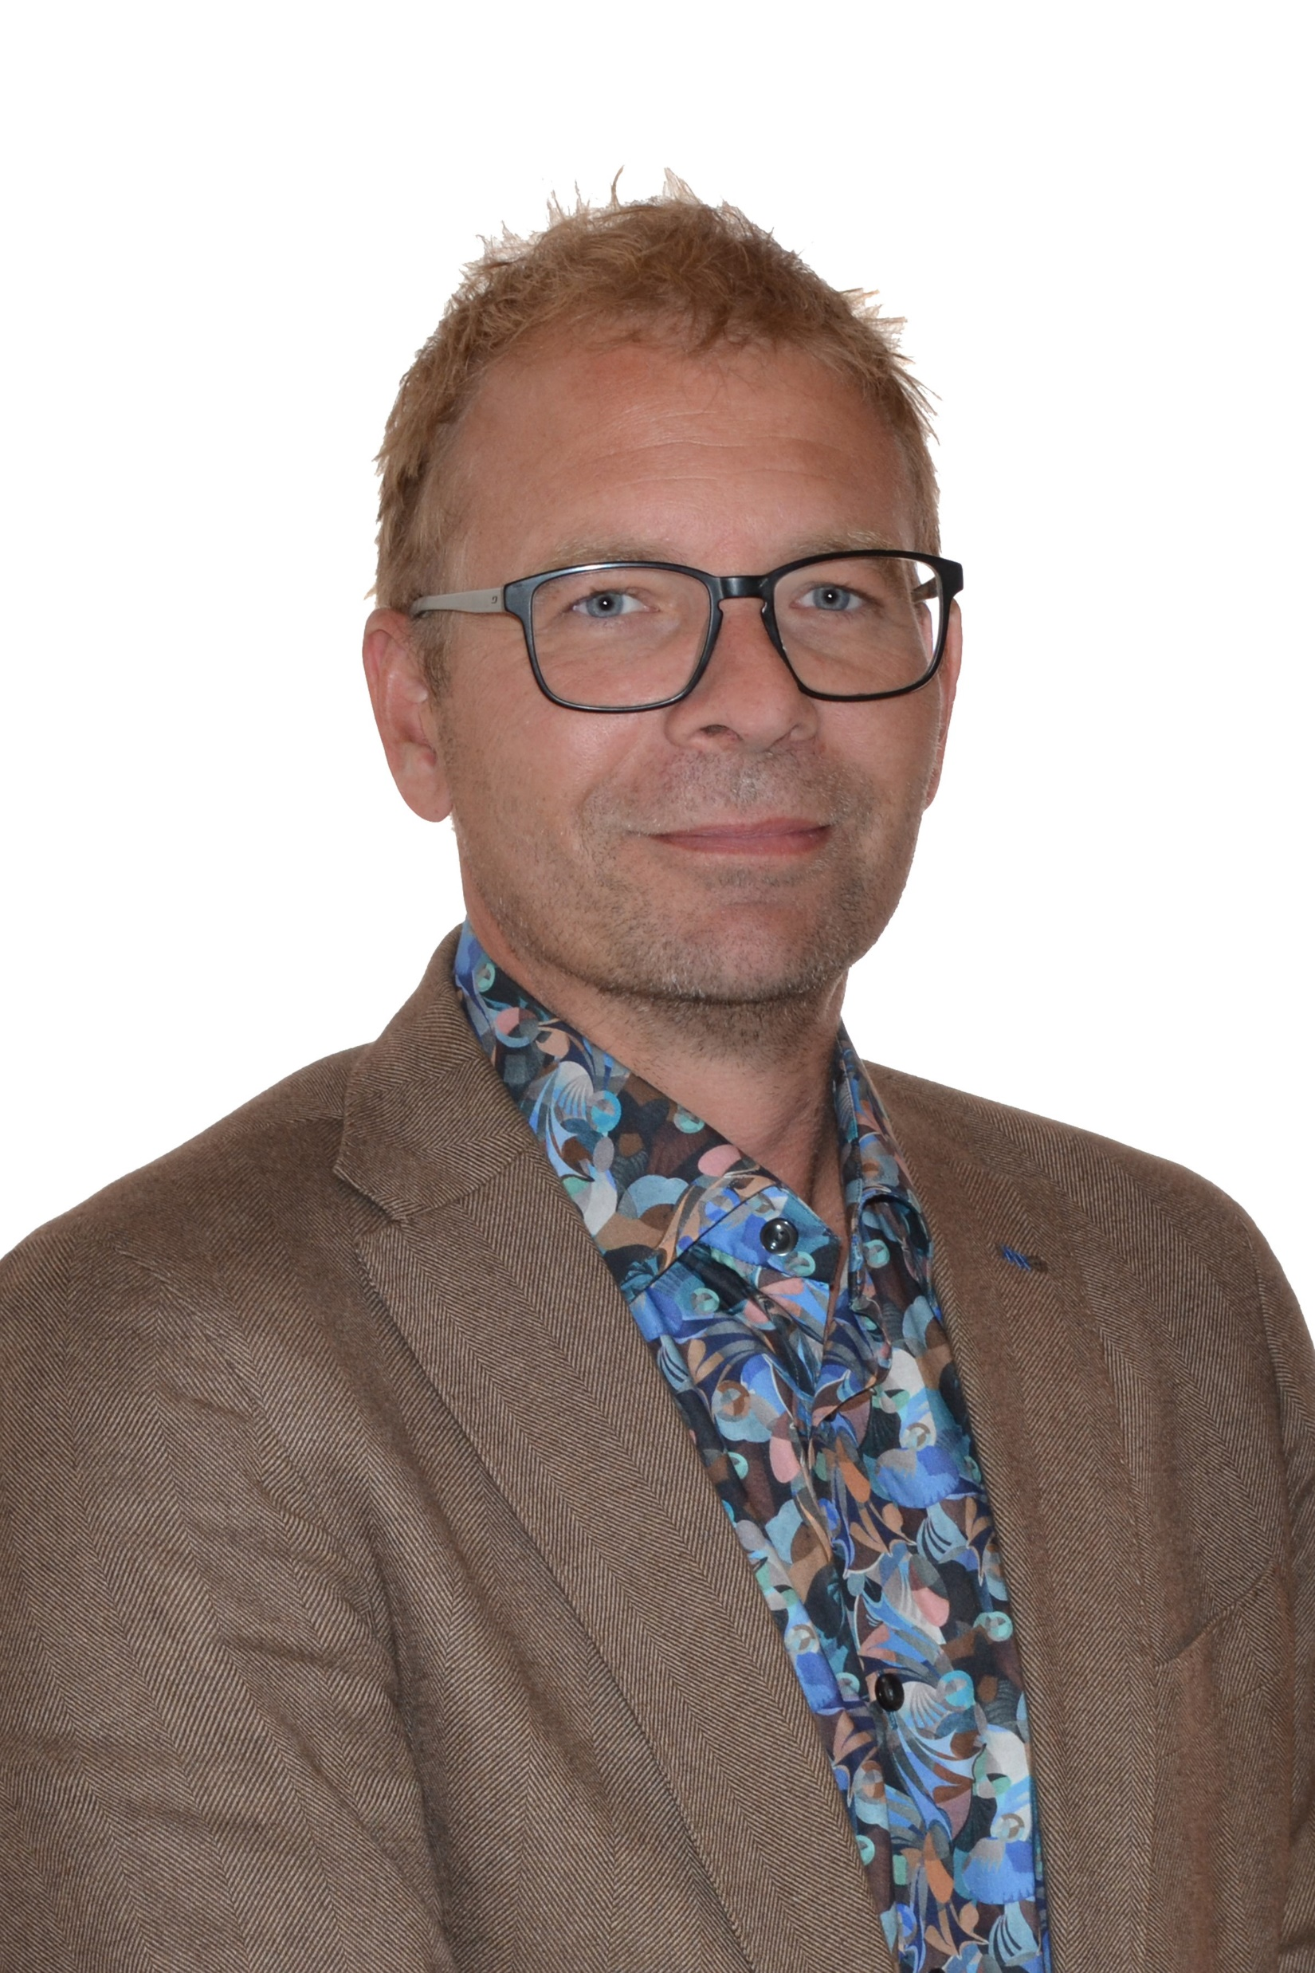

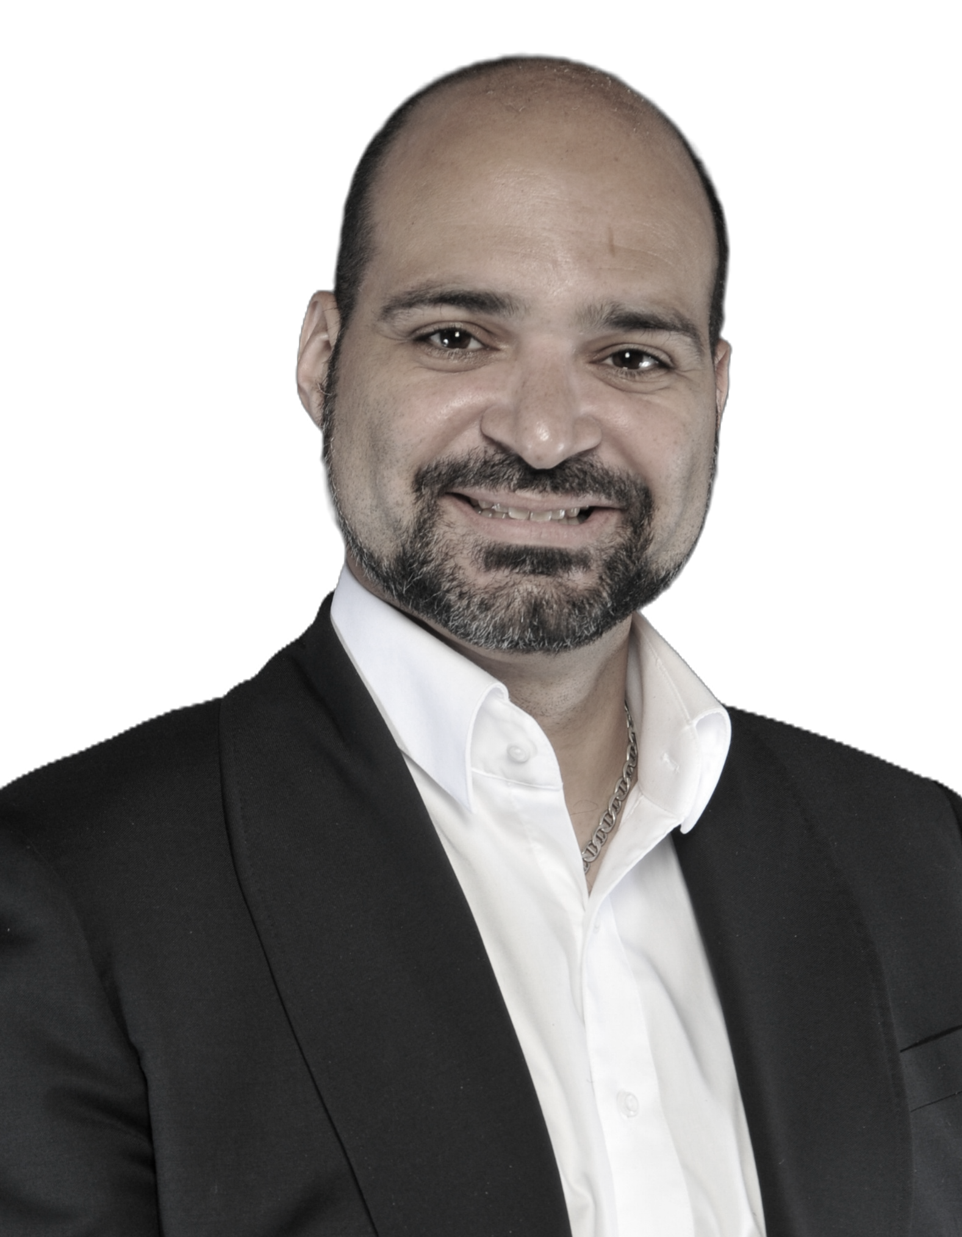
Experienced Team of Mine Builders & Operators
Pascal Hamelin, ing. │ President & CEO
Mining engineer with 34 years of experience in project management, and operating mines.
Has many years of experience in underground precious metal operations
Holder of a degree in mining engineering and member of the Ordre des ingénieurs du Québec (Ing.) and of the Professional Engineers Ontario (P. Eng)
Alain Lévesque, CPA │ CFO
Accountant with 30 years experience in public listed companies.
Has experience in financing, M&A, managing project startup for public listed mining companies.
Holder of a degree in accounting, and member of the Ordre des CPA du Québec.
Loïc Bureau, ing. │ COO
Geological engineer since 2006
Was General Manager at Pershimco in Mexico, Panama and Canada
Before joining Abcourt operations Team, he was coordinator of activities of the Mineral Technology Department at Cegep de l’Abitibi-Temiscamingue in Rouyn-Noranda.
Director of Abcourt between 2022 and January 2026. COO since January 2026
Robert Gagnon, Géo. │ VP Exploration
Geologist with over 25 years experience in exploration, mineral processing, and education
President of Pershimex from 2013 until May 2023 when acquired by Abcourt.
Holder of a degree in geology and member of the Ordre des Géologues du Québec (géo.)
Dany Cenac-Robert│VP Corporate Dev. & Communication
Over 20 years of experience in strategic communications and financial markets.
With the company since 2018
Past director of Orex Exploration
Annie Migneault│ General Manager
Holder of a Bachelor's degree in Business Administration
has over 20 years of experience in the entrepreneurial world.
Before joining the Abcourt team in 2023, she held a senior executive position at Technominex, an exploration services company in the Abitibi Camp.

Slide 6
Capital Structure
Capital Structure
As of 2026-02-14
Shares Outstanding: 1,192,393,720
Warrants: 742,057,894 (avg 0,09)
Options: 44,456,800 (avg 0,075)
Fully Diluted: 1,978,908,414
52w high/low S.P. : $ 0.04-$0.125
3M daily volume avg: +/- 2,0 M
Cash available: +/- 23M CAD as of 2026-02-01
Market Cap: 120M CAD as of 2026-02-01
Analyst Coverage
Red Cloud Securities
Couloir Capital
Eric Lemieux
Institutional Investor
NQ Investissement Minier (Qc Govt.)
Glencore

Slide 7
Strong financial Partnership
Abcourt has 2 significant financial partners.
Glencore
30M USD in a credit facility established 2026-01-31,
Interest: SOFR plus 2.5%,
First tranche: 18.1M USD transferred to Abcourt on Feb.2nd to advance Sleeping Giant and working capital,
Second tranche: 11.9M USD to be disbursed in December 2026 to replace the credit facility with Nebari,
5 years terms with capital repayment to begin in January 2027,
Right to participate in future project financing,
Offtake agreement for all future metal production.
Nebari
12M USD in a credit facility set to expire in July 2028,
Interest: SOFR plus 12%,
3 years terms with capital repayment to begin on the third year,
The credit facility is planned to be paid off in December 2026 with the second tranche from Glencore.

Slide 8

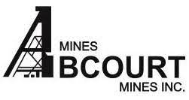
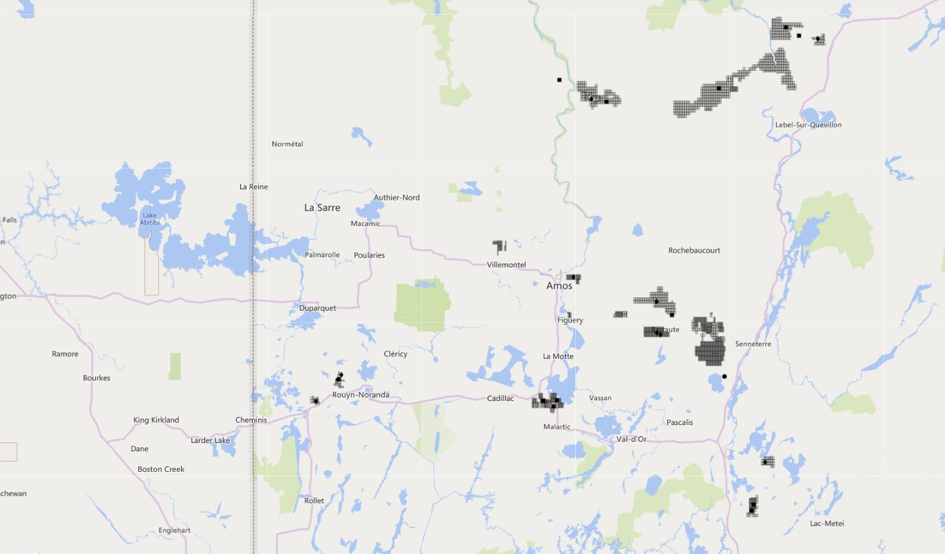
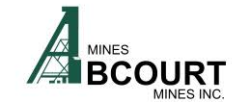
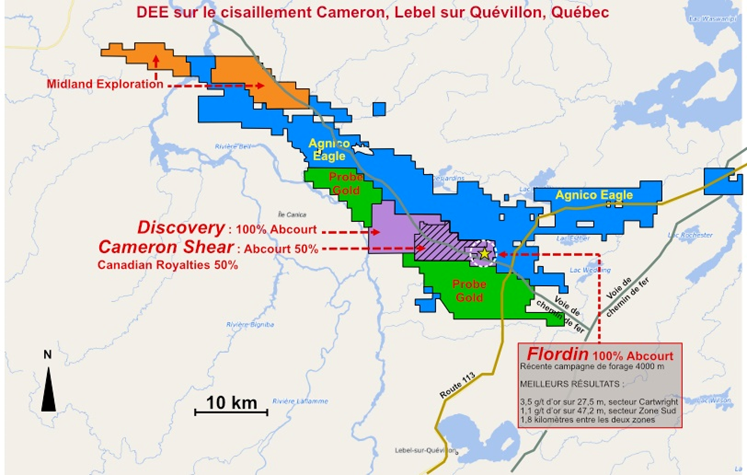
Projects Portfolio
4
3
Gold asset
1
5
Zn-Pb-Ag asset
1 | Sleeping Giant (100%)
2 | Laflamme (22%)
3 | Discovery (100%)
4 | Flordin-Cartwright (100%)
5 | Cameron Shear (51%)
6 | Jonpol (100%)
7 | Elder Mine & Tagami (100%)
8 | Aldermac - Cu (100%)
9 | Abcourt-Barvue - Zn (100%)
10 11 12 13 14 15 | Vendôme - Zn (100%) Pershing-Manitou (100%) Courville (100%) Malartic (49%) Villebon (100%) Forsan (100%)
2
Cu asset
Sleeping Giant Mine & 950 tpd Mill
6
9
10
12
11
7
8
13
15
14
Abcourt.ca TSX-V: ABI

Slide 9
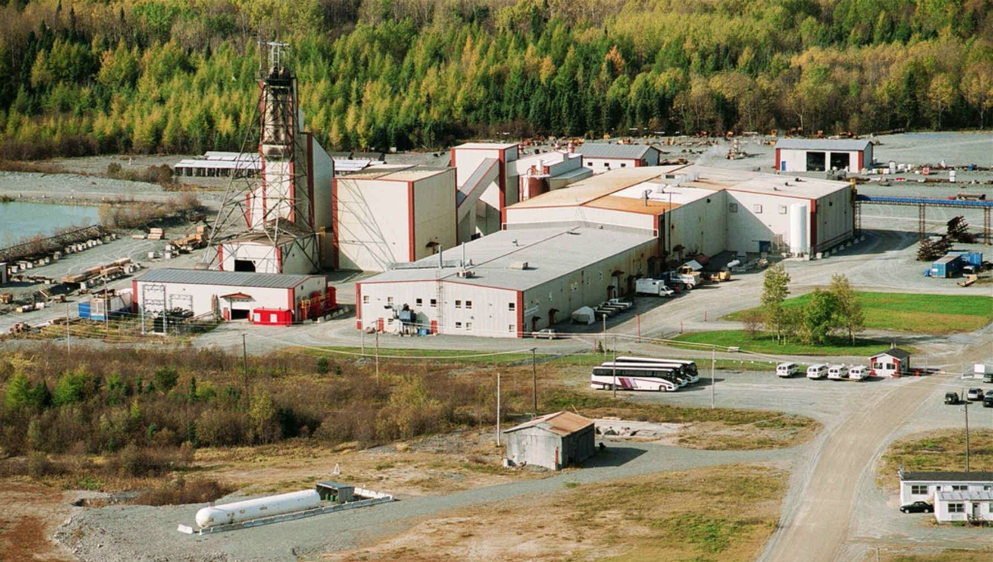
Sleeping Giant: Positive 2023 PEA leading to construction
Base Case Scenario : Gold Price : 1800 $ US/oz, Exchange Rate : 1.00 USD = 1.30 CAD, Discount Rate : 5 %
NPV_{5%} after taxes and mining duties (M CAD) | 54.4
IRR after taxes and mining duties (%) | 33.3
Initial Capital Costs (preproduction) (M CAD) | 42.0
Average Annual Production (oz) | 30,100 @ avg 340 tpd
Mill Net Recovery (%) | 96.7
Average Diluted Gold Grade (g/t Au) | 8.10
Life of Mine (excluding preproduction) (years) | 5.8
Gold Produced (oz) | 181,300
All In Sustaining Cost (USD/oz) | 1,120
Total Unit Operating Cost (CAD/tonne milled) | 321
Operating Cashflow (M CAD)/Year | 30
Top of sensitivity analysis in the PEA (2,100USD/oz)
NPV5% after taxes (M CAD) 90.6
IRR after taxes and mining duties (%) 49.9

Slide 10
Mine XYZ: Economic potential at 4,000 USD/Oz Au
What is the potential of a similar project at 4,000 USD gold price?
All In Sustaining Cost (USD/oz) | 1,400
Average Annual Production (oz) | 30,000 oz/Year
Potential margin per ounce at 4,000 USD/oz | 2,600 USD/oz
Operating Cashflow (M USD)/Year | 78M USD / 108M CAD
Gold Produced (oz) | 180,000
Life of Mine (years) | 6.0
Total margin @ 3,600 USD | 396M USD
Total margin @ 4,000 USD | 468M USD
Total margin @ 4,400 USD | 540M USD
Next Steps for Sleeping Giant Project
Ramp up development and production toward 2,500 oz per month within 15 months
Fill the mill and grow gold production
Get to positive cashflow
Ongoing resource modelling and extending LOM beyond 6 years
Update the PEA

Slide 11
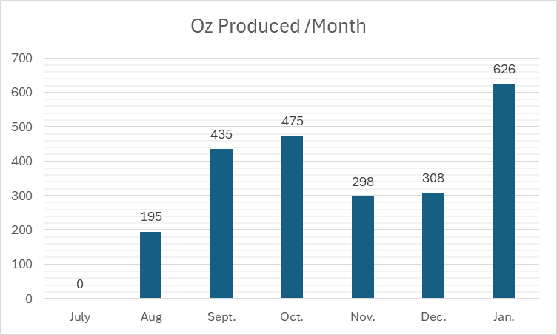
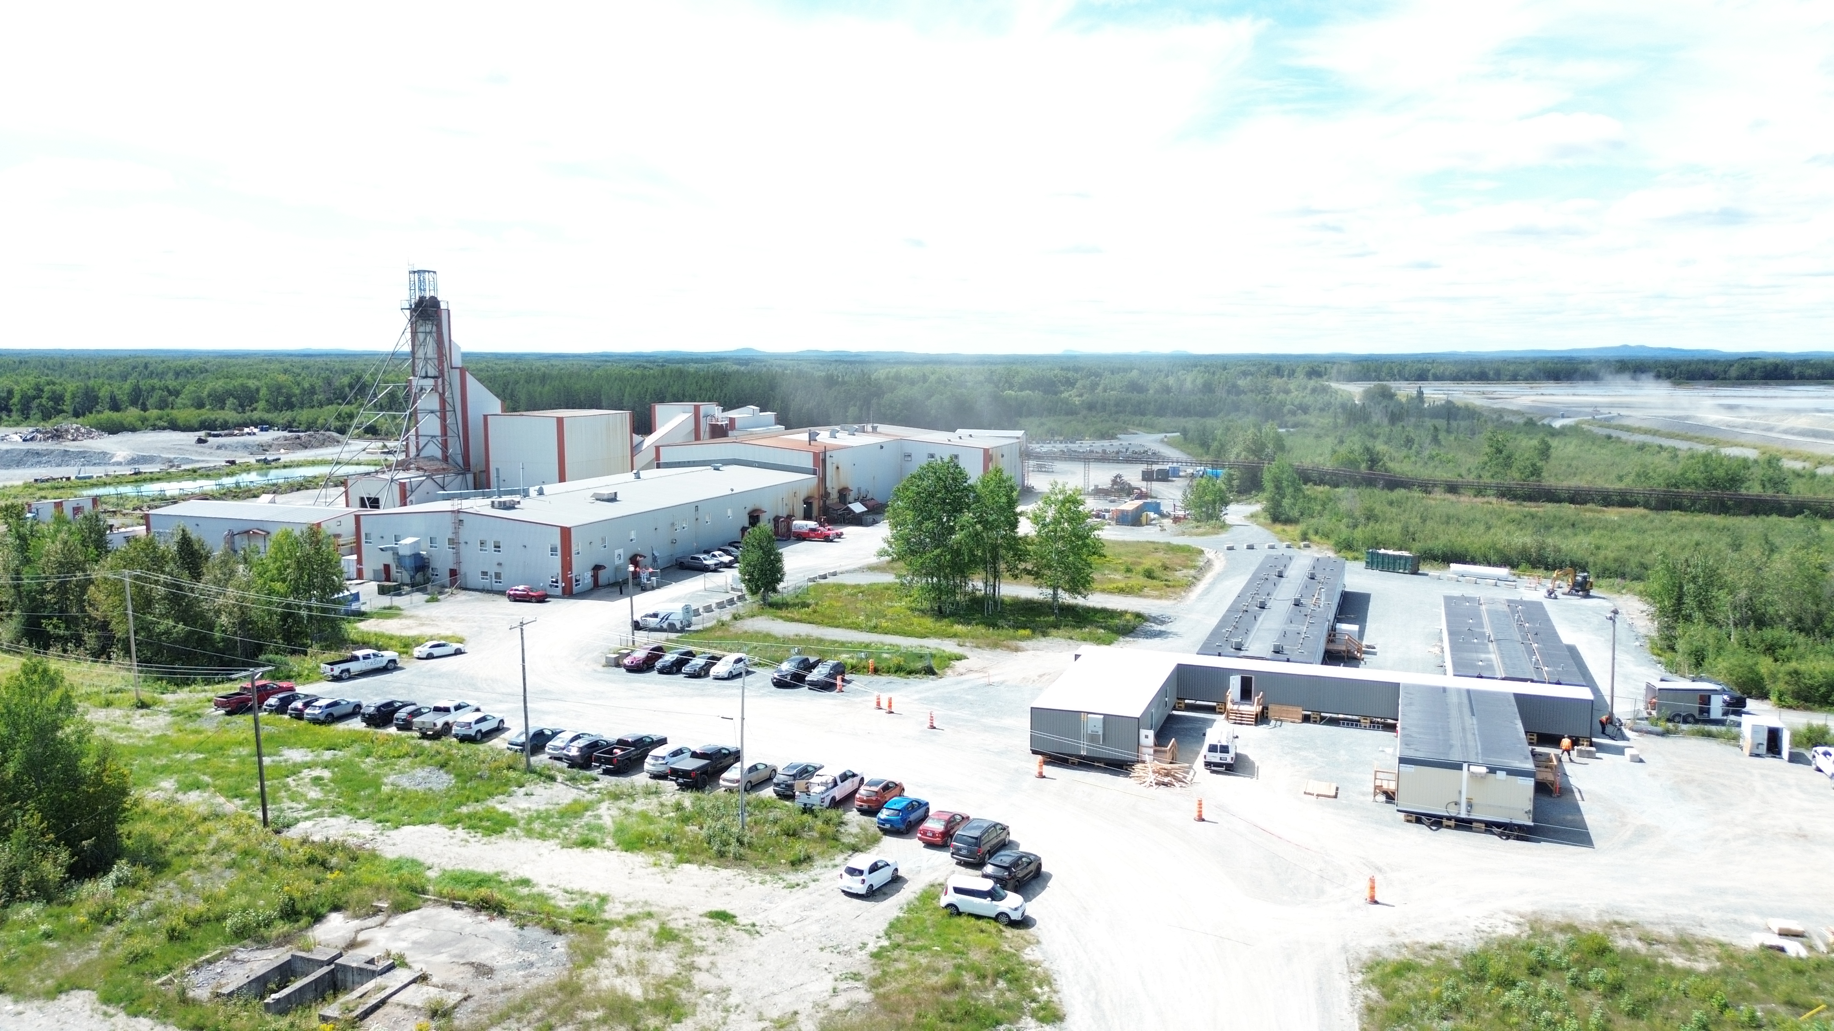
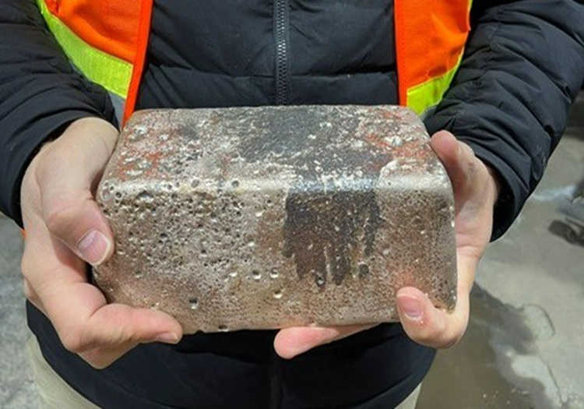
Rapidly progressing Production Rate

Slide 12



Some facts supporting the Ramp up in production
High-grade historical gold mine | All infrastructure in place & operational | Fully permitted operation
Over 1987 to 2014, 3.36M tonnes mined at 10.29 g/t Au to produce 1,073,111 oz Au Average historical recovery rate of 96.7% Shaft with access to 22 mine levels to depth of 1,175 m. Past development, electrical systems and ventilation systems are in very good working condition | CIP mill with an optimal rate of 800 tpd processed ore from the Elder Mine from August 2016 to August 2022. Currently processing Sleeping Giant ore. 50 persons sleep camp operational since September 2025 Tailings facility is operational with long-term capacity Only 85 km north of mining-friendly town of Amos in Abitibi | Mining leases and environmental certificates of authorization are in good standing for a maximum of 950 tpd gold mine Environmental bond is in place. The mine is on the power grid and supplied with 100% electricity coming from Hydro-Quebec green hydro-electricity.

Slide 13
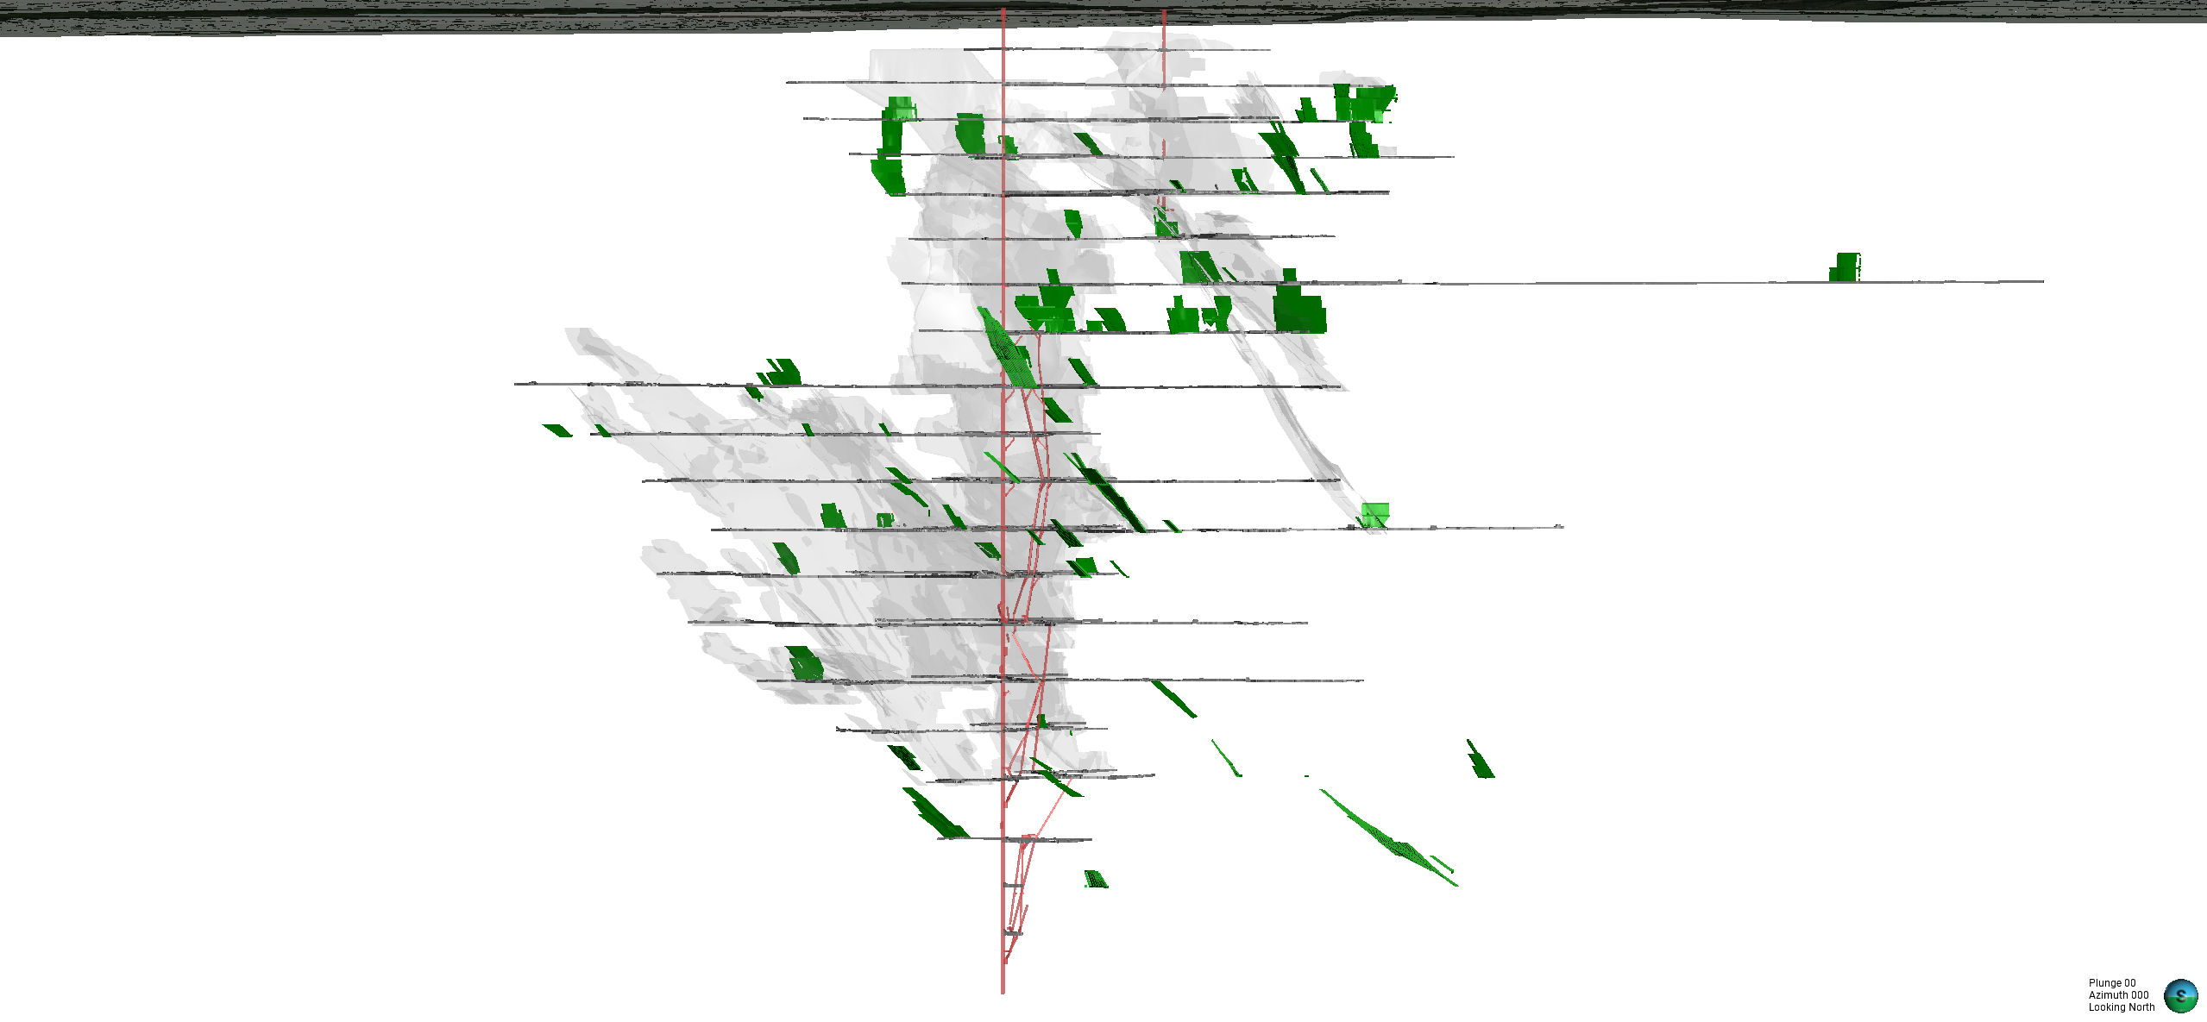
Sleeping Giant: More Resources Upsize Potential
Surface
0.6 m @ 58.1 g/t
0.5 m @ 71.2 g/t
Mined Out
0.5 m @ 130.4 g/t
Deswick Stope Optimizer
0.5 m @ 170 g/t
Blue Sky
Not or Very Little Drilled
0.5 m @ 112.5 g/t
Signifiants High Grade Intercepts Above­ 25 g/t Au
Not Included in Resources
0.5 m @ 65 g/t
Structural Trends
0.5 m @ 116 g/t
High Grade 785 N
With Additionnal Targets
1 m @ 90.6 g/t
1 m @ 75.3g/t
Looking North

Slide 14
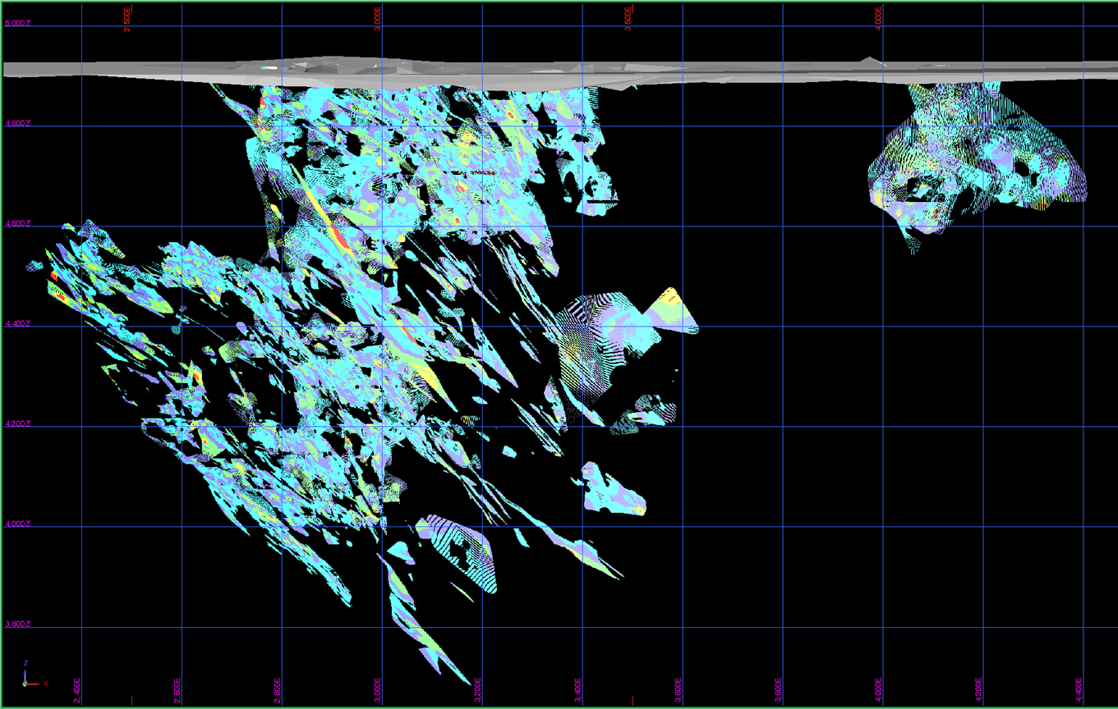
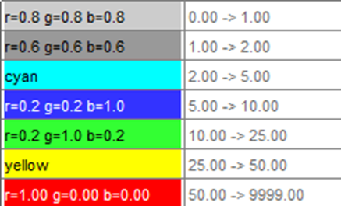
Sleeping Giant: Demonstrating Resource Upside
Modeled 846 distinct gold structures from 1.19 million metres of drilling
Many structure yet to be fully explored
Maintained indicated resources while increased inferred resources by 212,800 oz
700% increase from the 2018 estimate
98% of this MRE is at a depth accessible from the existing shaft
All planned mining material is coming from indicated resources until 2027
Currently converting resources for Q2 2027
2 drill rigs are drilling.
December 2022 NI 43-101 Compliant Mineral Resource Estimate (MRE)
Category | Tonnes | g/t Au | Gold (oz)
M&I resources | 755,000 | 7.14 | 173,300
Inferred resources | 884,000 | 8.74 | 248,300
See slide 14 for the notes to the 2022 MRE
Section view looking North of the 846 gold structures within the deposit

Slide 15
Sleeping Giant Mine: Notes to the 2022 MRE
Notes to the Sleeping Giant 2022 MRE
The independent and qualified persons for the 2022 MRE, as defined by NI 43-101 are Olivier Vadnais-Leblanc, P. Geo. and Eric Lecomte, ing, all from InnovExplo Inc.
These mineral resources are not mineral reserves because they do not have demonstrated economic viability. The results are presented undiluted and are considered to have reasonable prospects of economic viability. The 2022 MRE follows the CIM Standards.
The estimate encompasses 846 mineralized lenses that were modelled using a minimal geological width of 0.5m using Genesis software.
A density value of 2.85 g/cm3 (based on measurements and mine et mill reconciliation) was assigned to all mineralized zones.
High-grade capping supported by statistical analysis was done on composites data and established at 95 g/t Au for all mineralized zones. Composites (0.5 m) were calculated within the zones using the grade of the adjacent material when assayed or a value of zero when not assayed.
The exigence of a Reasonable Prospect of Eventual Economical Extraction is fulfilled by the use of cut-off grades based on reasonable mining parameters and locally constrained within Deswik Stope Optimizer shapes using a minimal mining width of 1.7 m for both potential methods. It is reported at a rounded cut-off grade of 4.25 g/t Au using the long-holes (LH) method, and 5.0 g/t Au, using the Room and Pillars (R&P) method. The cut-off grades were calculated using the following parameters: mining cost = C$213.96/t (LH) to C$261.56/t (R&P); processing cost = C$35.10/t; G&A = C$22.09/t; gold price = US$1,650.00/oz and USD:CAD exchange rate = 1.30. The cut-off grades should be re-evaluated in light of future prevailing market conditions (metal prices, exchange rates, mining costs etc.).
The estimate was completed using a sub-block model in Surpac 2022. A 4m x 4m x 4m parent block size was used (1m x 1m x 1m sub-blocked). Grade interpolation was obtained by Inverse Distance Squared (ID2) using hard boundaries.
The mineral resource estimate is classified as Indicated and Inferred. The Inferred category is defined with a minimum of two (2) drill holes within the areas where the drill spacing is less than 75 m and shows reasonable geological and grade continuity. The Indicated mineral resource category is defined with a minimum of three (3) drill holes within the areas where the drill spacing is less than 30 m and shows reasonable geological and grade continuity.
The number of metric tonnes was rounded to the nearest hundred, following the recommendations in NI 43-101 and any discrepancies in the totals are due to rounding effects. The metal contents are presented in troy ounces (tonnes x grade / 31.10348) rounded to the nearest hundred.
The independent and qualified persons for the 2022 MRE are not aware of any known environmental, permitting, legal, political, title-related, taxation, socio-political, or marketing issues that could materially affect the Mineral Resource Estimate.

Slide 16
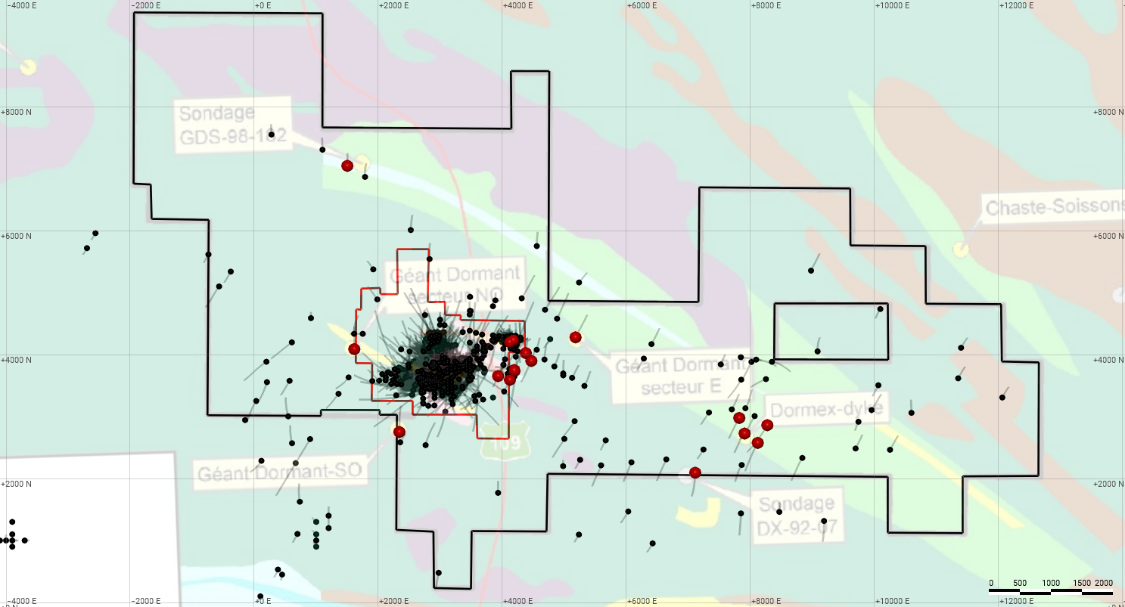
Sleeping Giant: Excellent Regional Potential
Mining Lease
Property Boundary
Drill Holes
Au Intercepts over 10 gpt
Historical Data (1988)
Hole 411-7
48.4 gpt Au over 0.7m

Slide 17
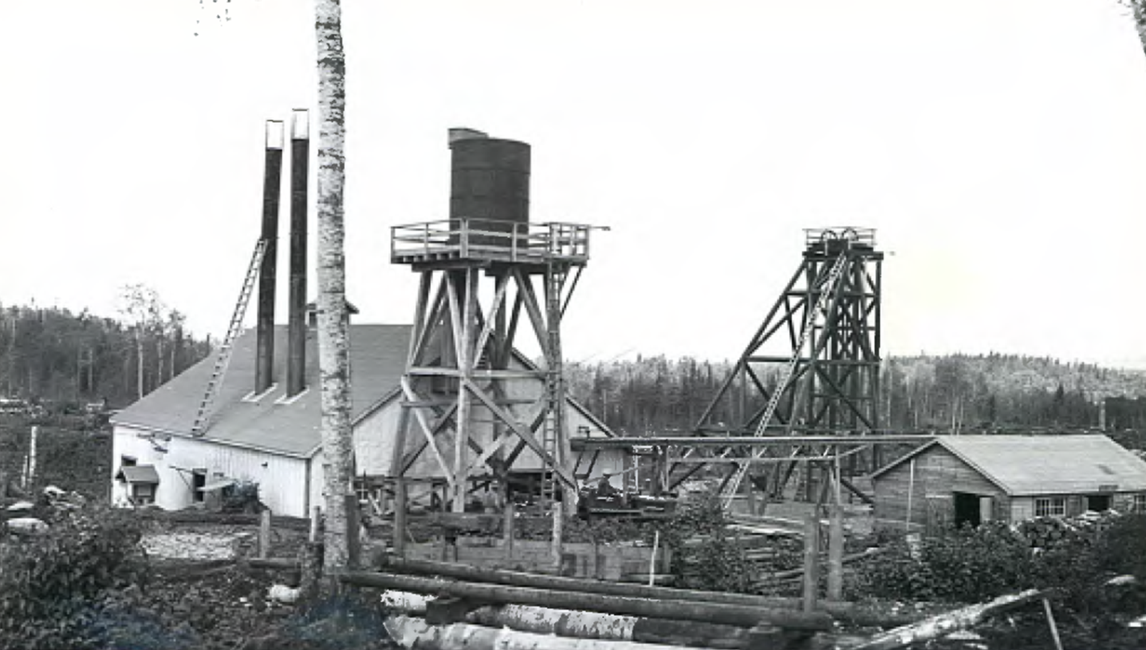
New focus in the Abitibi Camp near the Cartwright Deposit
The Flordin deposit was explored by Cambior in the 1980’s
The Cartwright area was discovered by prospectors in the 1930’s
Both deposits are along the Cameron shear.
The sector is accessible by road.
Located 35 km north of Lebel-sur-Quévillon, and less than 200 km from Val-d’Or
138km between Sleeping Giant and the Flordin/Cartwright deposits through forestry roads

Slide 18
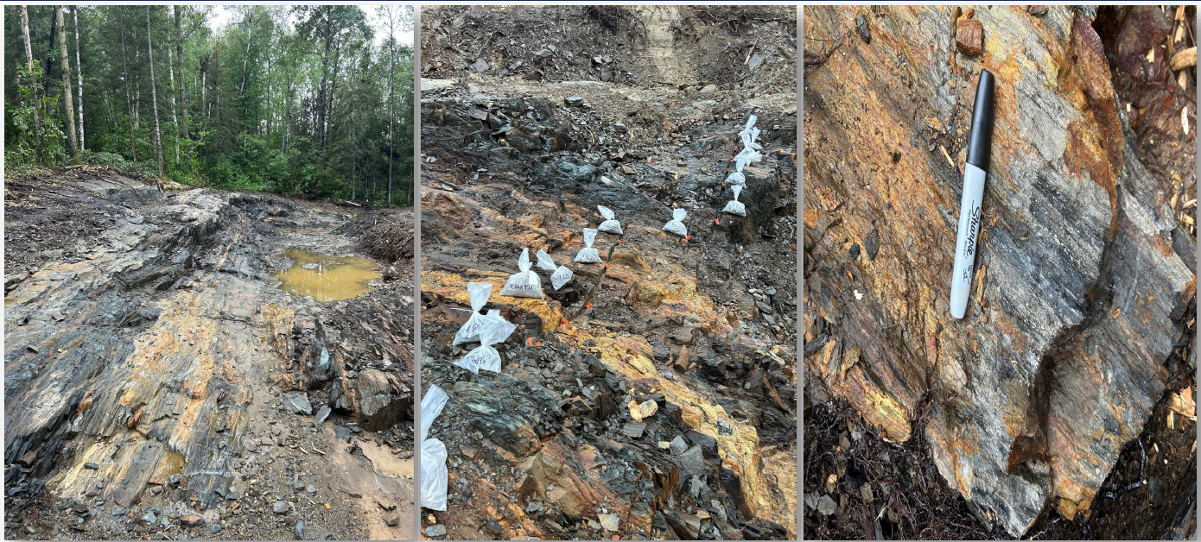
Flordin-Cartwright: New Gold Discovery in July 2024
Best Channel Intersection: 22,7 g/t over 7,0 m

Slide 19
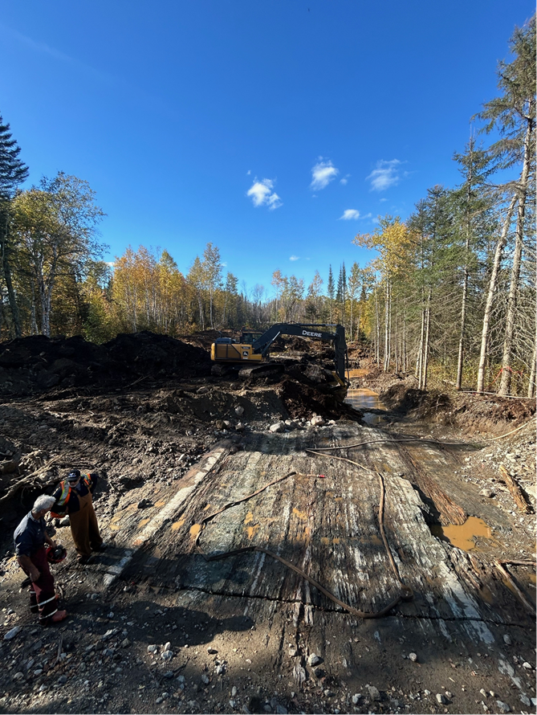
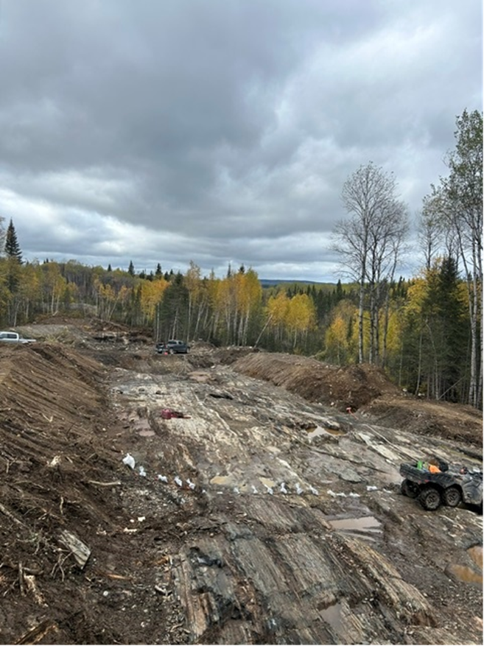
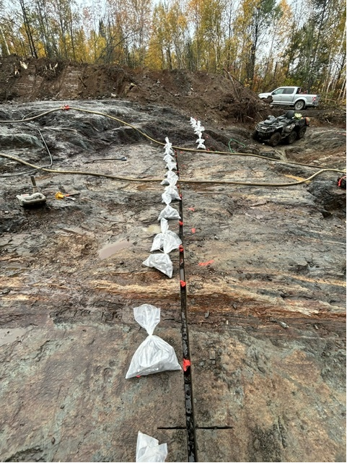
Flordin-Cartwright: Expanding the discovery from October 2024 to September 2025
Best Channel Intersection in Phase 2: 10,4 g/t over 12,0 m

Slide 20
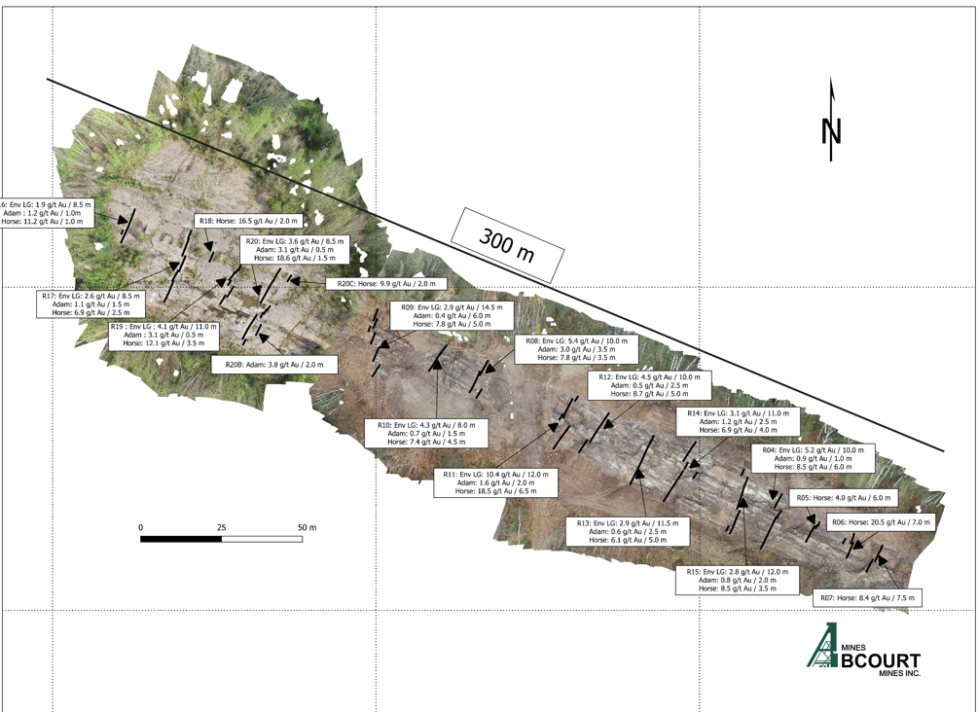
Flordin-Cartwright: Exposing a significant gold zone over 300 metres long
20 channels taken every 10-15m,
Average width of 15 to 20m,
Average grade of 5.0 gpt,
Open at depth and longitudinally

Slide 21
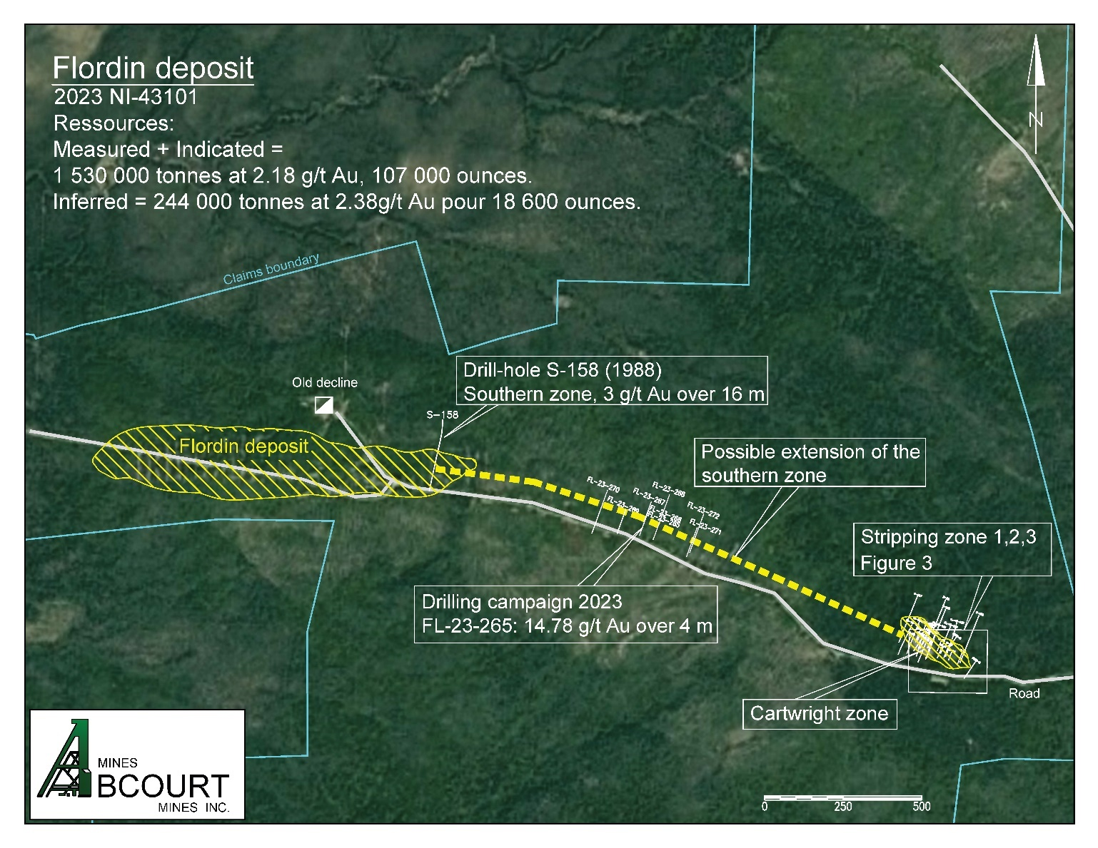
Flordin-Cartwright: Already drill results from 2023 to 2025 along a 2km corridor
A potential two kilometres Corridor
Abcourt exposed the gold mineralization over 200m long in the stripped area at Cartwright in 2024, and increased the stripped area to 650m in 2025.
Abcourt identified the same type of mineralization in hole FL-23-265, 50m below surface, 1 km west of Cartwright.
Cambior identified the same type mineralization at 300m depth from previous drilling in 1988 in hole S-158, 2km west of Cartwright.
Stripping 2025

Slide 22
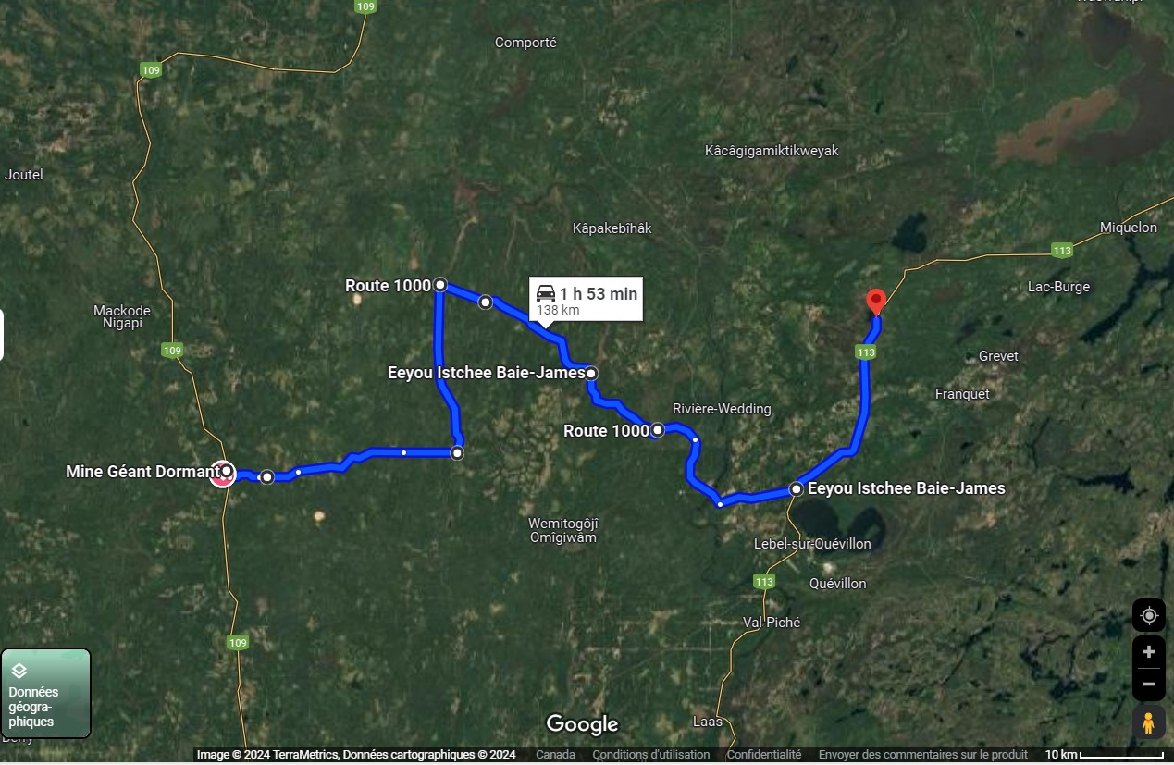
Flordin Deposit: Resources near the Sleeping Giant Mill
Sub-vertical deposit beginning with open pit on surface with underground extension evaluated with long hole mining parameters.
The Flordin deposit is 138 km East of the Sleeping Giant Mill.
This MRE reflects the results of approximately 73,400 m of drilling, of which 34,900 m were carried out from 2010 to 2020.
The MRE was carried out by the firm InnovExplo of Val d'Or.
May 2023 NI 43-101 Compliant Mineral Resource Estimate (MRE)
Potential open pit mining (cut off at 0,5 g/t Au) |  |  | Potential long holes mining (cut off at 3,1 g/t Au) |  |  | Potential room & pillars mining (cut off at 4,6 g/t Au)
Tonnes | Grade (g/t Au) | Ounces Au | Tonnes | Grade (g/t Au) | Ounces Au | Tonnes | Grade (g/t Au) | Ounces Au
Measured Resources
86,000 | 2.58 | 7,100 | 0 | 0.00 | 0 | 0 | 0.00 | 0
Indicated Resources
1,444,000 | 2.15 | 99,900 | 227,000 | 3.75 | 27,500 | 1,000 | 5.46 | 200
Measured & Indicated Resources
1,530,000 | 2.18 | 107,000 | 227,000 | 3.77 | 27,500 | 1,000 | 6.22 | 200
Inferred Resources
244,000 | 2.38 | 18,600 | 323,000 | 3.83 | 39,800 | 8,000 | 5.16 | 1 300
138 km
See slide 15 for the notes to the MRE
MRE total
134,700 ounces of Measured and Indicated Resources in 1,758,000 tonnes at an average grade of 2.38 g/t Au
59,700 ounces of Inferred Resources in 575,000 tonnes at an average grade of 3.23 g/t Au

Slide 23
Flordin Deposit: Notes to the 2023 MRE
Flordin Deposit: Notes to the 2023 MRE
1. The effective date of the 2023 MRE is May 15, 2023.
2. The independent and qualified persons (as defined by NI 43-101) for the 2023 MRE are Olivier Vadnais-Leblanc, P.Geo., Carl Pelletier, P.Geo., Eric Lecomte, P.Eng., and Simon Boudreau, P.Eng., from InnovExplo Inc,
3. The mineral resource estimate follows the CIM Definition Standards (2014) and follows the CIM MRMR Best Practice Guidelines (2019).
4. These mineral resources are not mineral reserves because they do not have demonstrated economic viability. The results are presented undiluted and are considered to have reasonable prospects for eventual economic extraction (RPEEE).
5. The estimate encompasses 364 mineralized veins and structures developed using Genesis and interpolated using LeapFrog Edge.
6. 1 m composites were calculated within the mineralized zones using the grade of the adjacent material when assayed or a value of zero when not assayed. High-grade capping supported by statistical analysis was done on composites and was set to 25 g/t Au.
7. The estimate was completed using a sub-block model in Leapfrog Edge. A 10m x 2m x 2m (X,Y,Z) parent block size and a 1.25m x 0.25m x 0.25m (X,Y,Z) sub block size was used.
8. Grade interpolation was obtained by Inverse Distance Squared (ID2) using hard boundaries.
9. A density value of 2.8 g/cm3 was assigned to all mineralized zones.
10. Mineral resources were classified into Measured, Indicated and Inferred. Measured resources are defined within a distance of 8m from underground or surface channel and from a minimum of three (3) drill holes in areas where the drill spacing is less than 50 m. Indicated resources are defined with a minimum of three (3) drill holes in areas where the drill spacing is less than 50 m. The Inferred category is defined with two (2) drill hole in areas where the drill spacing is less than 75 m where there is reasonable geological and grade continuity.
11. The requirement of a reasonable prospect of eventual economic extraction is satisfied by having cut-off grades based on reasonable parameters for potential surface and underground extraction scenarios, minimum widths and constraining volumes. The estimate is presented for potential underground scenarios (realized in Deswik) over a width of 1.7m for blocks 16m high by 16m long at a cut-off grade of 3.10 g/t Au for the long-hole method (LT) and 4.60 g/t Au for the conventional room and pillar (RP) method. Cut-off grades reflect the actual geometry and dip of the mineralized envelopes. The pit of the 2023 mineral resource estimate is locally constrained by an optimized surface in Whittle using a rounded cut-off grade of 0.5 g/t Au. Cut-off grades reflect the actual geometry and dip of the mineralized envelopes. The cut-off grades were calculated using the following parameters: a slope of 50° in the rock and 30° in the overburden, a pit mining cost = C$4.65/t, an underground mining cost of C $169.50/t for LT and C$262.00/t for CP, a processing cost of C$21.50/t, general and administrative costs of C$12.00/t, selling costs of C$5.00/oz, a price of gold of US$1,650 per ounce, a USD/CAD exchange rate of 1.33 and a mill recovery rate of 91.7%. Cut-off grades should be re-evaluated in light of future market conditions (metal prices, exchange rates, mining cost, etc.).
12. The number of metric tonnes was rounded to the nearest thousand, following the recommendations in NI 43-101 and any discrepancies in the totals are due to rounding effects. The metal contents are presented in troy ounces (tonnes x grade / 31.10348) rounded to the nearest hundred. Numbers may not add up due to rounding.
13. The independent and qualified persons for the 2023 MRE are not aware of any known environmental, permitting, legal, political, title-related, taxation, socio-political, or marketing issues that could materially affect the Mineral Resource Estimate.

Slide 24
2026 Objectives
Growing & Advancing Sleeping Giant
Grow production at Sleeping Giant to 2,500 oz Au per month
3,000 m per month drill program at Sleeping Giant to extend LOM (Began in December 2023)
To declare commercial production in Q2 2026
Advance Cartwright-Flordin
Extend the surface showing of Carthwright to the West
Drill 20,000m below the showing in 2026
Corporate initiative
Discuss custom milling with potential client allowing Sleeping Giant to become the central hub in the region.

Slide 25
Why Abcourt?
1
Near term gold producer
2
Resource growth potential within the camp
Contact Us
475, avenue de l’église, Rouyn-Noranda, Quebec
info@abcourt.com
Investor Relations:
IR@abcourt.com
3
Custom Mill material from other sites
4
Many upcoming catalysts

Slide 26
Appendices

Slide 27
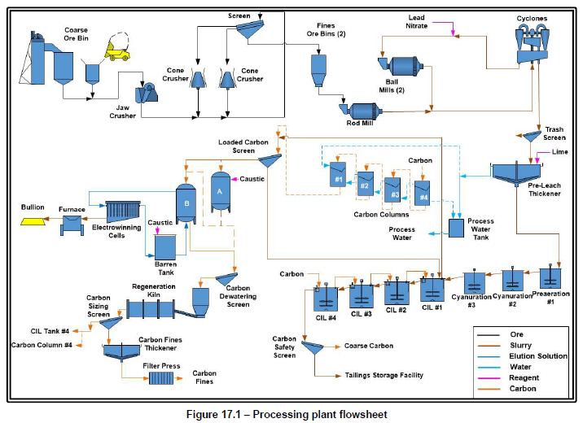
Sleeping Giant Mill: Process Flowsheet
InnovExplo - Expertise minière

Slide 28
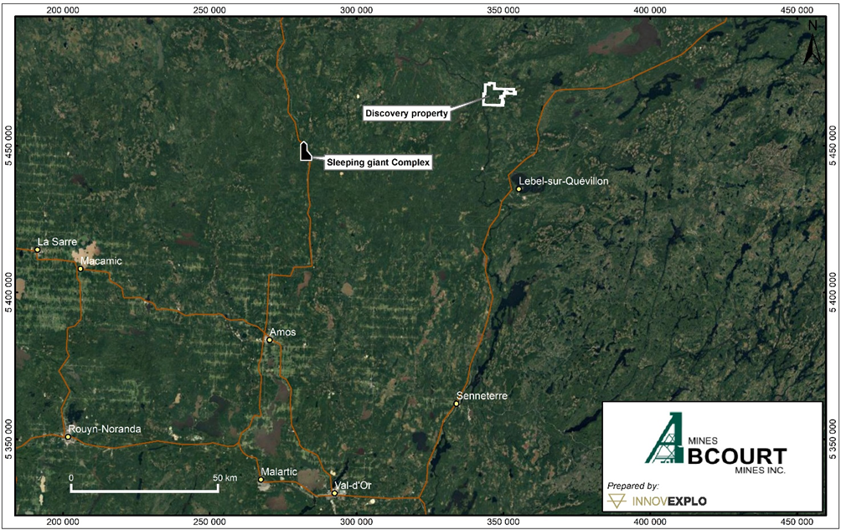
Discovery Deposit: Building Resources near the Sleeping Giant Mill
Sub-vertical deposit beginning on surface with underground extension
The Discovery deposit is 80 km East of the Sleeping Giant Mill.
This MRE reflects the results of approximately 158,000 m of drilling, of which 35,551 m were carried out from 2010 to 2018.
The MRE was carried out by the firm InnovExplo of Val d'Or.
April 2023 NI 43-101 Compliant Mineral Resource Estimate (MRE)
Discovery Deposit
Underground Mineral Resources (at 3 g/t Au cut-off)
Classification | Tonnes | Grade | Ounces
 | (t) | (g/t Au) | (oz Troy Au)
Indicated | 955,000 | 5.09 | 156,300
Inferred | 1,573,000 | 5.21 | 263,400
Open-Pit Mineral Resources (at 0.5 g/t Au cut-off)
Classification | Tonnes | Grade | Ounces
 | (t) | (g/t Au) | (oz Troy Au)
Measured | 8,000 | 3.44 | 900
Indicated | 223,000 | 2.86 | 20,500
Total Measured+Indicated | 231,000 | 2.88 | 21,400
Inferred | 397,000 | 3.15 | 40,300
Discovery Deposit Total Resources
Total Measured+Indicated | 1,186,000 | 4.66 | 177,700
Total Inferred | 1,970,000 | 4.80 | 303,700
See slide 13 for the notes to the MRE

Slide 29
Discovery Deposit: Notes to the 2023 MRE
Discovery Deposit: Notes to the 2023 MRE
The effective date of the 2023 MRE is Mars 28, 2023.
The independent and qualified persons (as defined by NI 43-101) for the 2023 MRE are Olivier Vadnais-Leblanc, P.Geo., Simon Boudreau, P.Eng.,and Eric Lecomte, P.Eng. from InnovExplo Inc,
The mineral resource estimate conforms to the CIM Definition Standards (2014) and follows the CIM MRMR Best Practice Guidelines (2019).
These mineral resources are not mineral reserves, because they do not have demonstrated economic viability. The results are presented undiluted and are considered to have reasonable prospects of economic viability.
The estimate encompasses 34 mineralized solids developed using LeapFrog Geo.
1 m composites were calculated within the mineralized zones using the grade of the adjacent material when assayed or a value of zero when not assayed. High-grade capping supported by statistical analysis was done on composites and was set to 35 g/t Au.
The estimate was completed using a sub-block model in Leapfrog Edge. A 16m x 1m x 16m (X,Y,Z) parent block size and a 4m x 1m x 4m (X,Y,Z) sub block size was used.
Grade interpolation was obtained by Inverse Distance Squared (ID2) using hard boundaries.
A density value of 2.82 g/cm³ was assigned to all mineralized zones.
Measured resources are defined inside a distance of 8m from an underground or surface channel within existing indicated resources. Indicated resources are defined with a minimum of two (2) drill holes within the areas where the drill spacing is less than 50m. The Inferred category is defined with a (1) drill holes within the areas where the drill spacing is less than 150 m. Data must show reasonable geological and grade continuity.
The Underground 2023 MRE is locally constrained within Deswik Stope Optimizer shapes using a minimal mining width of 1.7 m for a potential Long-Hole underground mining method (potential block of 16m X 16m), with no maximum width. It is reported at a rounded cut-off grade of 3 g/t Au using the long-hole mining method. The open pit 2023 MRE is locally constrained within Whittle surfaces using a rounded cut-off grade of 0.5 g/t Au. The cut-off grades were calculated using the following parameters: mining cost Open Pit = C$4.65/t; mining cost Underground= C$169.50/t; processing cost = C$21.50/t; G&A = C$12.00/t; selling costs = C$5.00/oz; gold price = US$1,650.00/oz; USD:CAD exchange rate = 1.33; and mill recovery = 96.0%. The cut-off grades should be re-evaluated considering future prevailing market conditions (metal prices, exchange rates, mining costs etc.).
The number of metric tonnes was rounded to the nearest thousand, following the recommendations in NI 43-101 and any discrepancies in the totals are due to rounding effects. The metal contents are presented in troy ounces (tonnes x grade / 31.10348) rounded to the nearest hundred. Numbers may not add up due to rounding.
The independent and qualified persons for the 2023 MRE are not aware of any known environmental, permitting, legal, political, title-related, taxation, socio-political, or marketing issues that could materially affect the Mineral Resource Estimate.

Slide 30
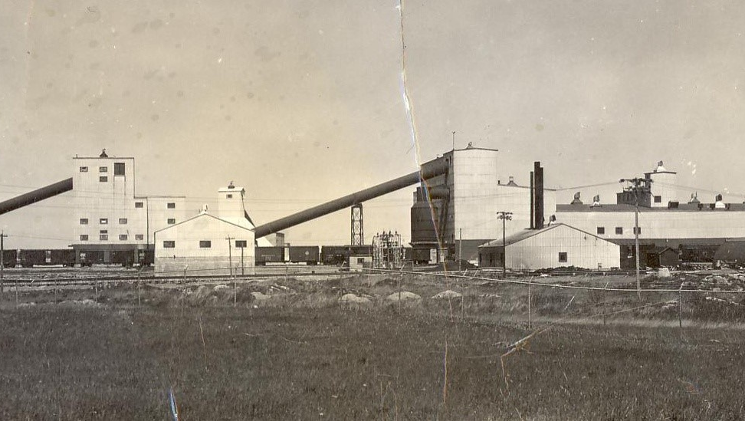

Abcourt-Barvue
Zn-Ag Project
100% owned
Abcourt-Barvue Project: Historical Resource Estimate
Category | Type | Tonnes | % Zn | g/t Ag | ZnEq
M&I resources | Combined | 8,083,000 | 3.06 | 55.45 | N/A
Inferred resources | Combined | 2,037,000 | 2.89 | 114.16 | N/A
Historical Resources were estimated in a NI 43-101 technical report titled “NI 43-101 Mineral Resources Report for the Abcourt-Barvue Property” with an effective date of February 28, 2014 and prepared by Jean-Pierre Bérubé (geological consultant and P.Eng). Resources were calculated based on US$0.96/lb zinc price, US$27.55/oz silver price and US$1.00:C$1.00 exchange rate. Cut-off grades were 1.99% ZnEq for open pit resources and 4.51% for underground resources
Location | 4,755 ha property located near Barraute, 60 km north of Val-d’Or Easily accessible via existing access roads and Highway 397
History | Zinc first discovered on the Barvue claims in 1950 Open pit mine operated from 1952 to 1957. Total of 5.0M tonnes of 2.98% Zn and 38.74 g/t Ag mined Underground mine operated from 1985 to 1990 by Abcourt Mines. Total of 632,319 tonnes of 5.04% Zn and 131.65 g/t Ag mined
Vendôme Property: Historical Resource Estimate
Category | Tonnes | % Zn | g/t Ag | % Cu
M&I Resources | 712,222 | 7.50 | 60.11 | 0.63
Inferred Resources | 305,769 | 4.30 | 36.77 | 0.49
Resources were estimated in a NI 43-101 technical report titled “NI 43-101 Resources Evaluation Report for the Vendôme Property” with an effective date of February 12, 2013 and prepared by Jean-Pierre Bérubé (geological consultant and P.Eng). Resources were calculated using the following parameters:
Density: 3.60 tonnes/m³
Minimum true width: 1.50 m with no cuts on high gold, silver, copper and zinc values
Minimum cut-off of C$55/tonne or 4.53% ZnEq
abcourt.ca
30
TSX-V: ABI

Slide 31
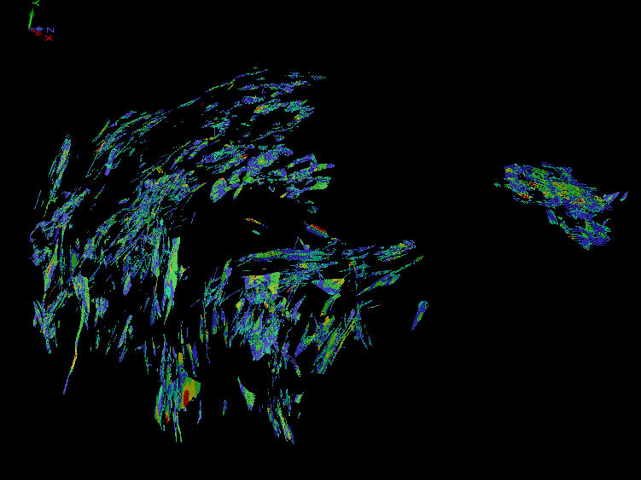
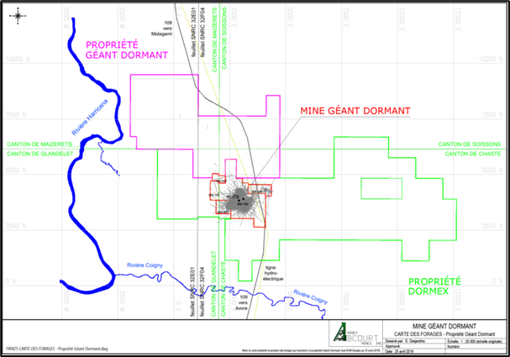

Sleeping Giant: Block Model, Plan view
InnovExplo - Expertise minière

Slide 32
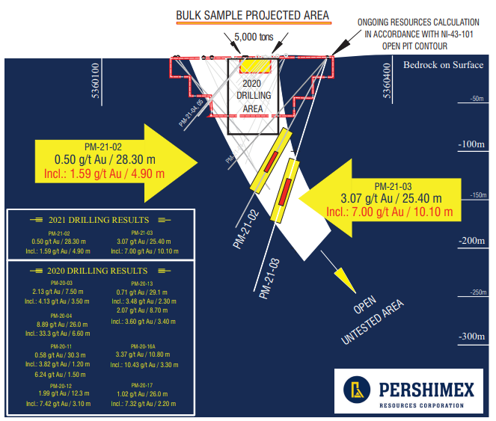
Courville Property
Pershing Manitou Project
124 km southeast of Sleeping Giant Mill and 65 km northeast of Val-d’Or
Subject to numerous drill programs and limited production over 1930s to 1960s
January 2022 resource estimate based on 28 surface diamond drill holes totaling 3,955 m
12 zones with true thickness of at least 2.0 m over an area of 150 m long, 150 m wide and to a depth of 180 m
Ministère de l’Energie et des Ressources Naturelles du Québec approved a 5,000-tonne bulk sample (7.2 g/t Au) from measured resources within a pit shell.
Mineralized materials were extracted in the Fall 2022.
Bulk sample processed at the Sleeping Giant in the winter 2024.
Reconciled Mill head grade of 1.74 gpt
Pershing-Manitou NI 43-101 Resource Estimate
Type | Category | Tonnes | g/t Au | Gold (oz)
Open pit | M&I resources | 9,600 | 6.93 | 2,140
 | Inferred resources | 500 | 0.62 | 10
Underground | M&I resources | 23,300 | 4.02 | 3,010
 | Inferred resources | 3,000 | 2.90 | 280
See NI 43-101 technical report titled “NI 43-101 Technical Report and Mineral Resource Estimate for the Pershing-Manitou Project” prepared by Kenneth Williamson (P.Geo) and Matthew DeGasperis (P.Geo) for Pershimex with an affective date of September 7, 2021. Cut-off grades of 0.50 g/t Au for open pit resources and 2.00 g/t Au for underground resources

